Slide 1
Near-Field MIMO-ISAR Millimeter-Wave Imaging
Josiah W. Smith
Advisor: Dr. Murat Torlak
Special Thanks to: Dr. Muhammet Yanik, Ashwin Baral, Bhaskar Upadhyay, and Jayson VanMarter

Slide 2
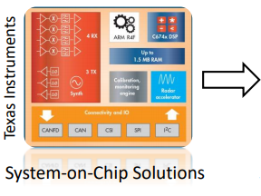
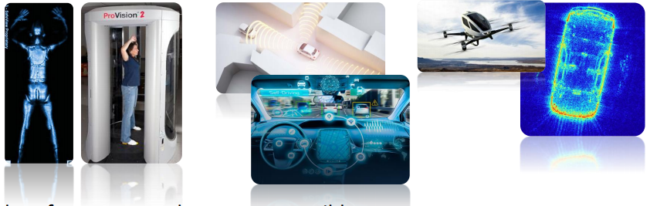
Motivation
Millimeter-wave (mmWave) imaging has a host of real-world applications ranging from security, packaging, automotive, medical, aerial imaging, etc.
Problems:
Create high-resolution 3D images using as few antenna elements as possible
Proposed Solution:
Combine MIMO (multiple-input-multiple-output) phased array techniques with synthetic aperture radar (SAR) imaging algorithms

Slide 3
Research Objectives
Data Capture
MIMO Conversion
Rectilinear Scanning
Cylindrical Scanning
Scanner Results
Goals:
Overcome issues inherent to MIMO multistatic virtual arrays with phase conversion
Develop a complete signal processing chain from data capture to image reconstruction
Design a system-level prototype imaging system implementing the complete algorithm

Slide 4
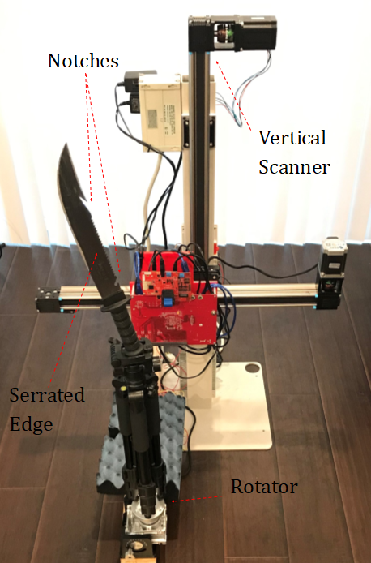
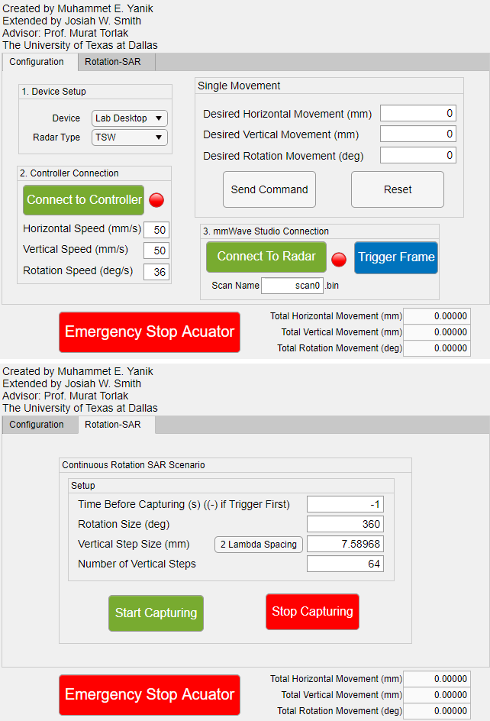
Data Capture
Data Capture
MIMO Conversion
Rectilinear Scanning
Cylindrical Scanning
Scanner Results
Mechanical Scanner
Horizontal (x) and vertical (y) scanning
Rotator controls target domain orientation
Custom MATLAB GUI
Interfaces with TI software for radar setup
Define scanning parameters
Automate data retrieval

Slide 5
MIMO Conversion
Data Capture
MIMO Conversion
Rectilinear Scanning
Cylindrical Scanning
Scanner Results
MIMO Virtual Array – TI AWR1443
2λ
λ/2
Physical Elements:
Rx
Rx
Rx
Rx
Tx
Tx
λ/4
Virtual Elements:
Vx
Vx
Vx
Vx
Vx
Vx
Vx
Vx

Slide 6
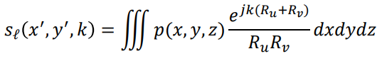
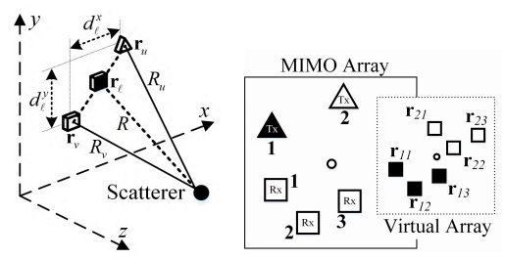
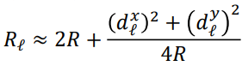
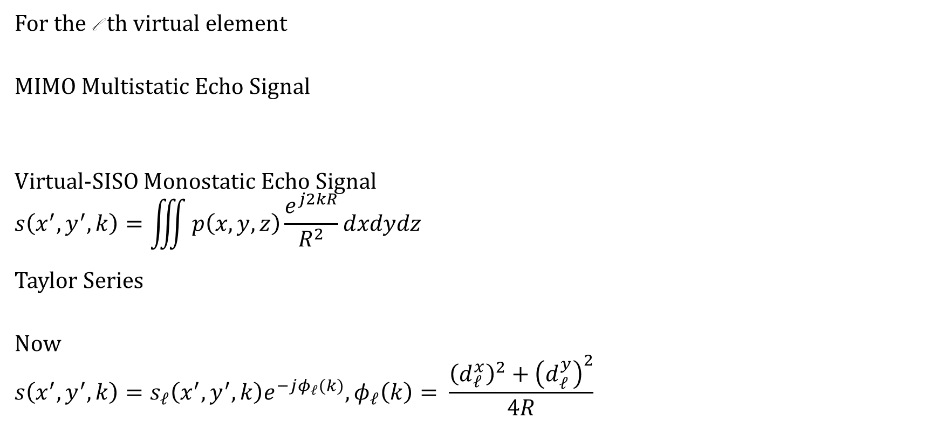
Multistatic to Monostatic Phase Conversion
For the l th virtual element
MIMO Multistatic Echo Signal
Virtual-SISO Monostatic Echo Signal
$$s\left(x^{′},y^{′},k\right)=\iiint{p\left(x,y,z\right)\frac{e^{j2kR}}{R^{2}}dxdydz}$$
Taylor Series
Now
$$s\left(x^{′},y^{′},k\right)=s_{ℓ}\left(x^{′},y^{′},k\right)e^{−jφ_{ℓ}(k)}, φ_{ℓ}\left(k\right)= \frac{{\left(d_{ℓ}^{x}\right)}^{2}+{\left(d_{ℓ}^{y}\right)}^{2}}{4R}$$

Slide 7
MIMO Multistatic Phase Conversion
Raw MIMO - Phase Profile of PSF
After MIMO Conversion - Phase Profile of PSF

Slide 8
Point Spread Function – Without Phase Conversion
Multistatic artifacts

Slide 9
Point Spread Function – With Phase Conversion

Slide 10
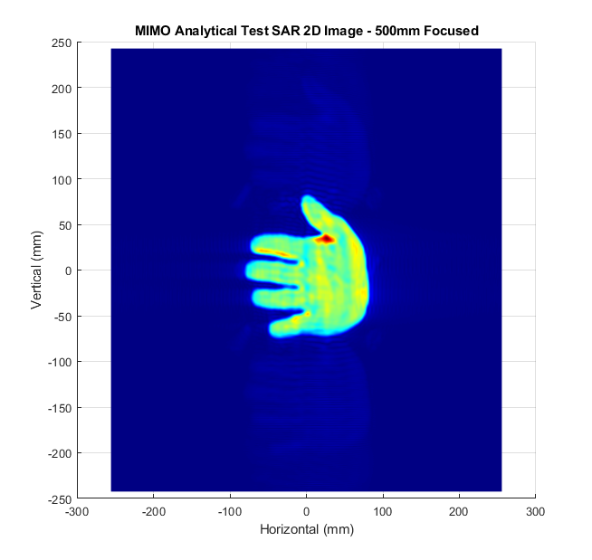

Phase Conversion 2-D Image
Without Phase Conversion (Vertical Ghosts)
With Phase Conversion (No Ghosts)

Slide 11
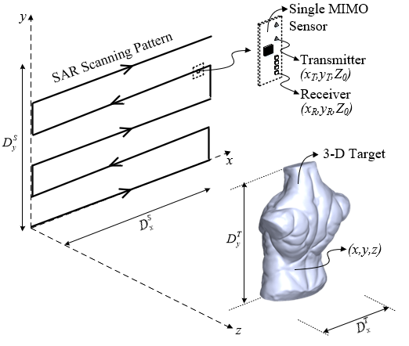
Rectilinear Scanning
Data Capture
MIMO Conversion
Rectilinear Scanning
Cylindrical Scanning
Scanner Results
3D target scene
TI MIMO radar board scanned across 2D plane
Reconstruction algorithms
Back-projection algorithm (BPA)
BPA matched filtering (MF)
Range migration algorithm (RMA)
Simulation Results

Slide 12
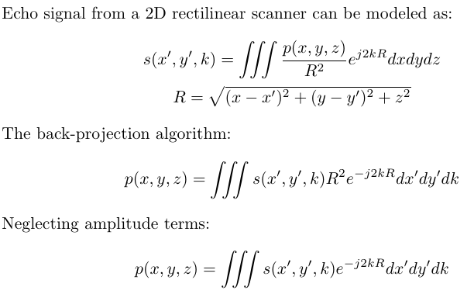
Back Projection Algorithm
Correlate echo signal with response from point reflector at each position in the target scene
Requires point by point calculation of integral
Infeasible due to excessive computational complexity
Baseline imaging algorithm

Slide 13
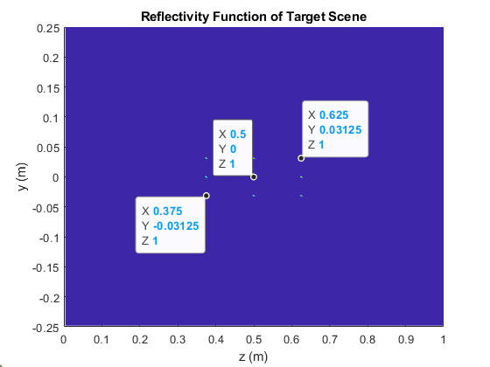
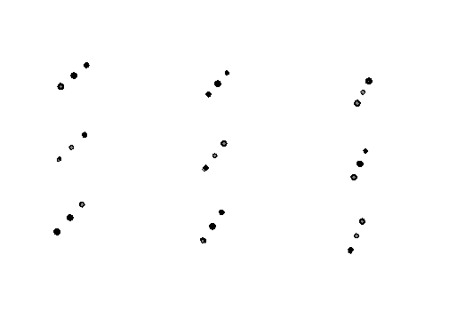
Grid of Points - Target Reflectivity Function
3D Reflectivity Function 2D Reflectivity Function

Slide 14
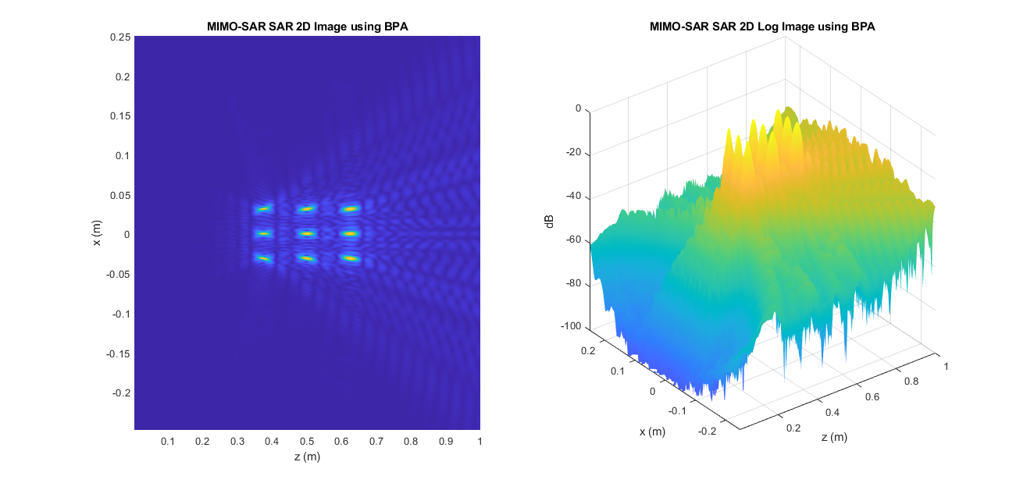
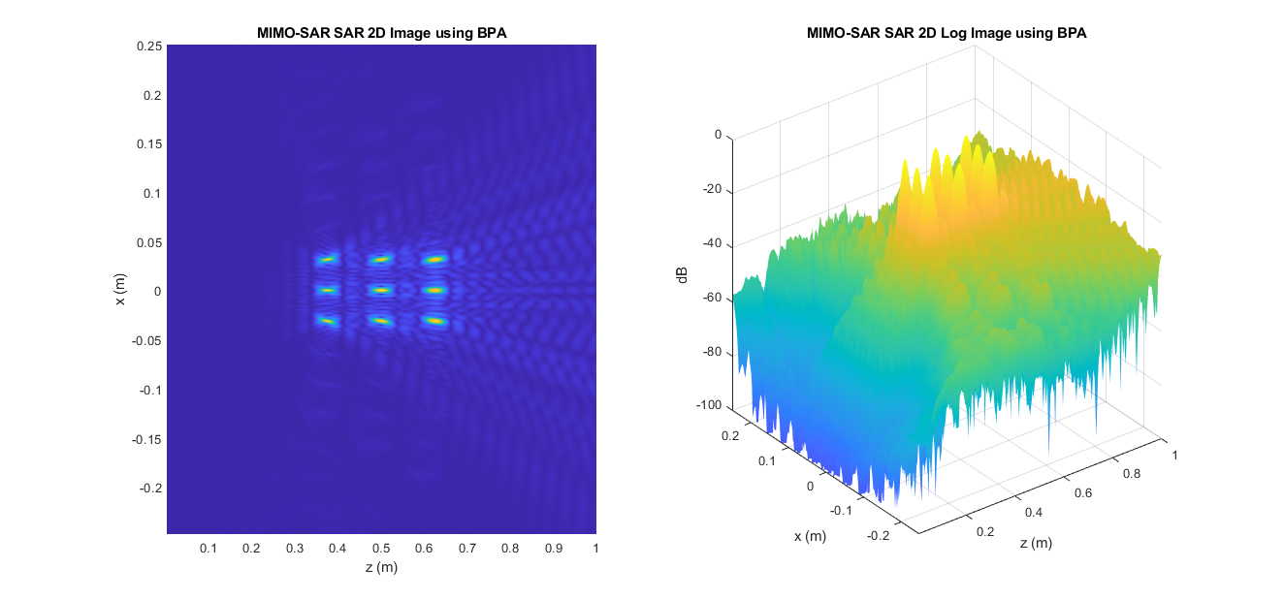
Back Projection Algorithm – 2D Simulations
Targets have uniform amplitude as expected
Computation Time: 30s
Without phase conversion:

Slide 15
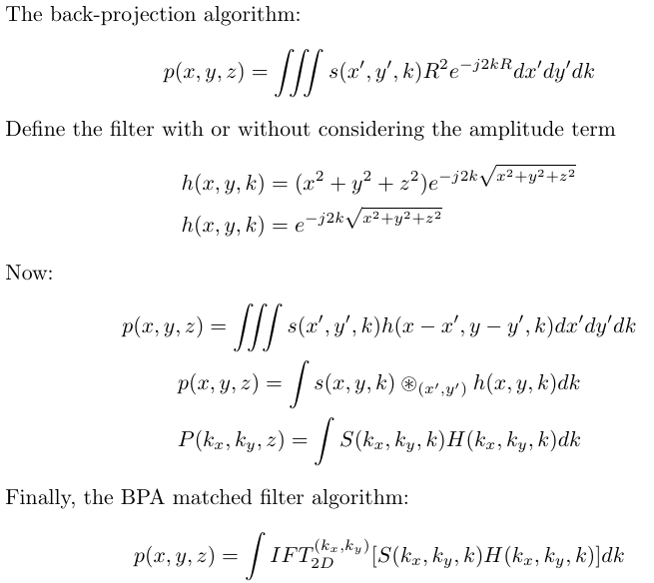
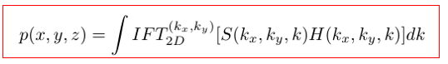
Matched Filter BPA Algorithm
Leverage Fourier convolution properties to simplify the integral to a single integral
Reduce computational complexity substantially

Slide 16
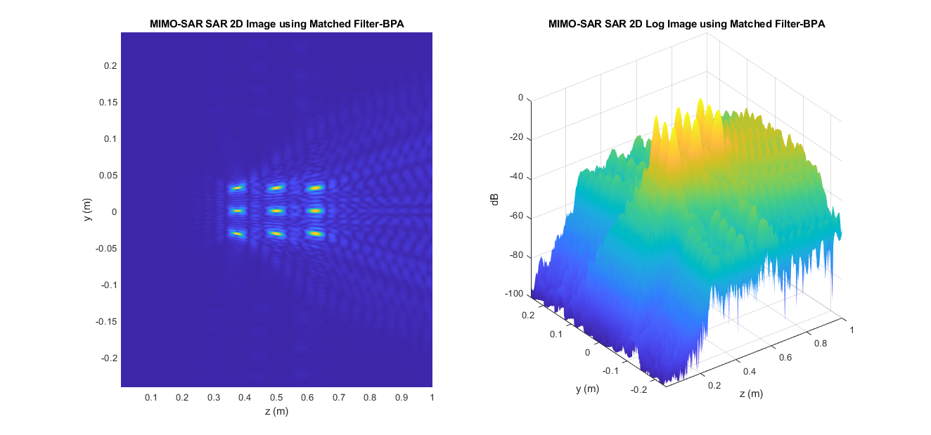
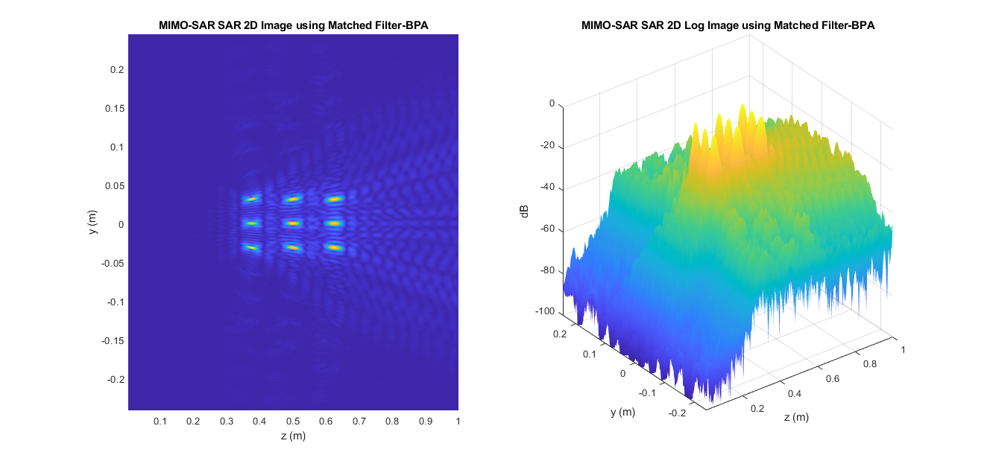
Matched Filter BPA – 2D Simulations
Again, targets have uniform amplitude
Computation Time: 300ms
Without phase conversion:

Slide 17
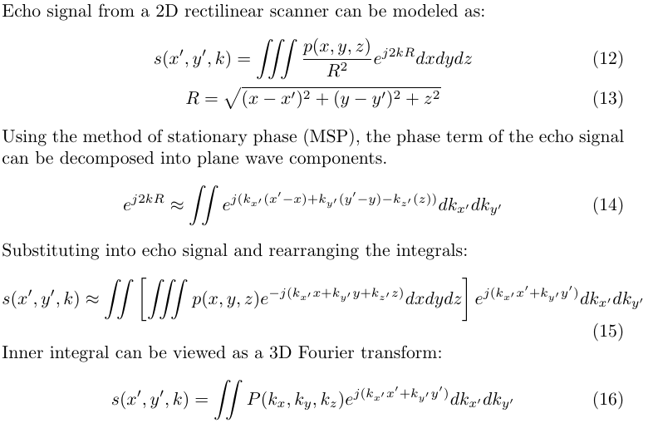
Range Migration Algorithm
Spherical wavefront
Decomposed by MSP

Slide 18
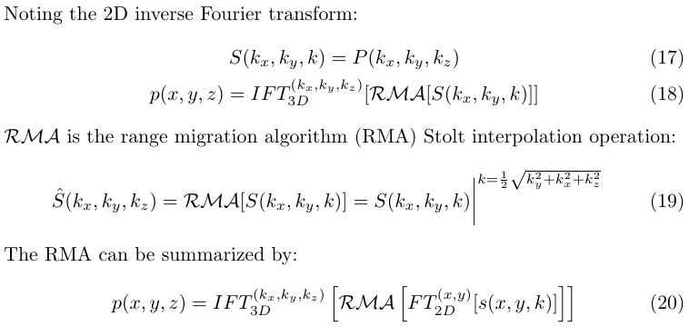
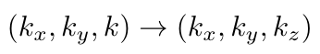
Range Migration Algorithm
*
Even more computationally efficient
Requires Stolt interpolation

Slide 19
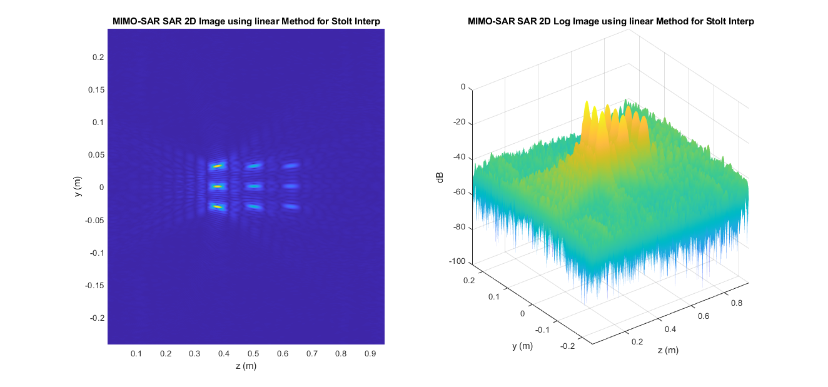
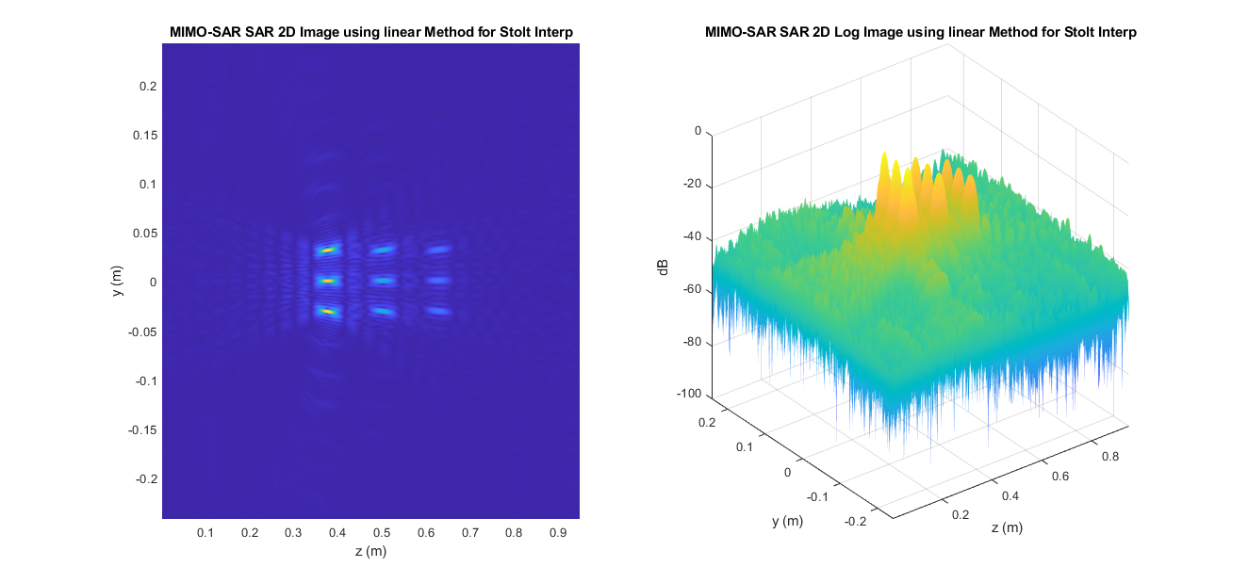
Range Migration Algorithm – 2D Simulations
Targets farther from radar have smaller amplitude
Computation Time: 70ms!!
Without phase conversion:

Slide 20
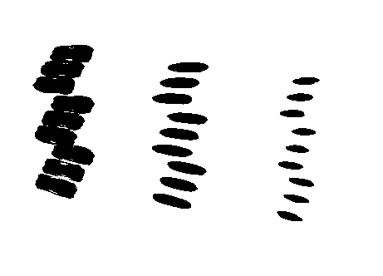
Range Migration Algorithm – 3D Simulations
Computational Time: 12s
Closer points have higher magnitude
Limited bandwidth -> decreased range spatial resolution

Slide 21
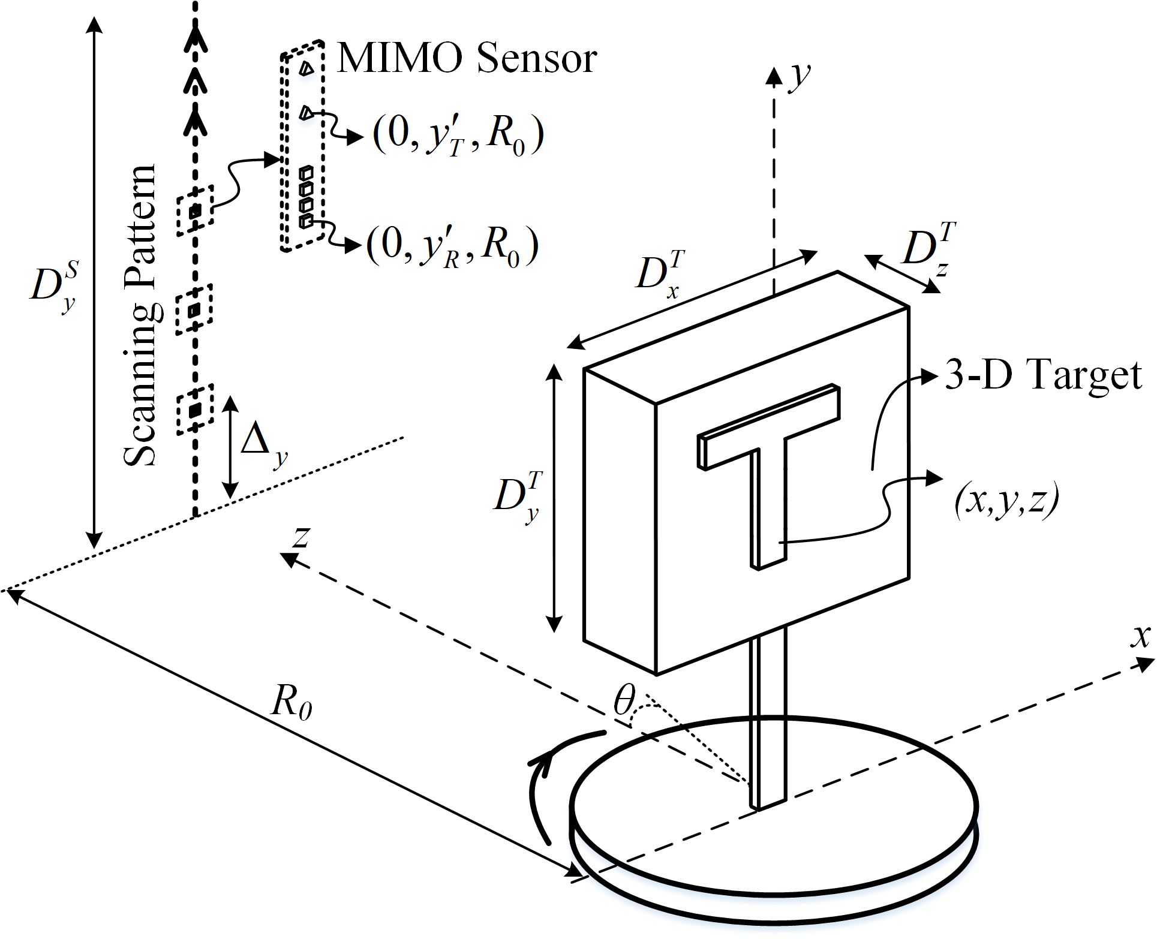
Cylindrical Scanning
Data Capture
MIMO Conversion
Rectilinear Scanning
Cylindrical Scanning
Scanner Results
3D target scene
TI MIMO radar board scanned across 1D plane, target rotated
Advantages: radar scans target from every side
Reconstruction algorithms
Back-projection algorithm (BPA)
Polar Formatting Algorithm (PFA)
Simulation Results

Slide 22
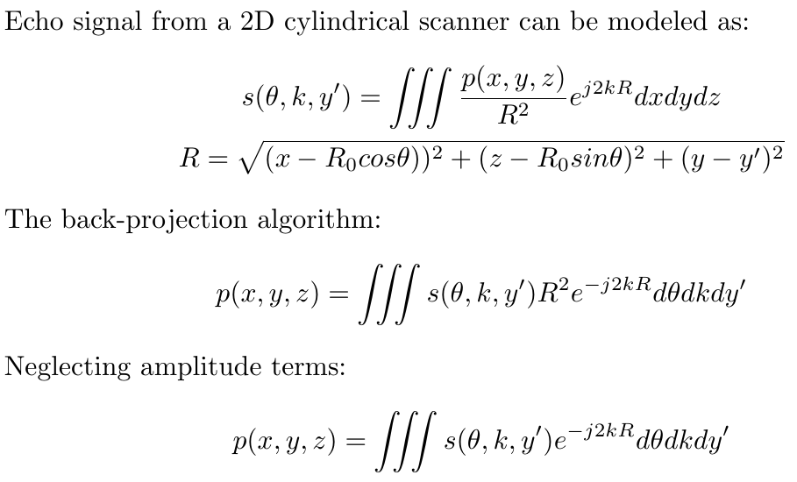
Back Projection Algorithm

Slide 23
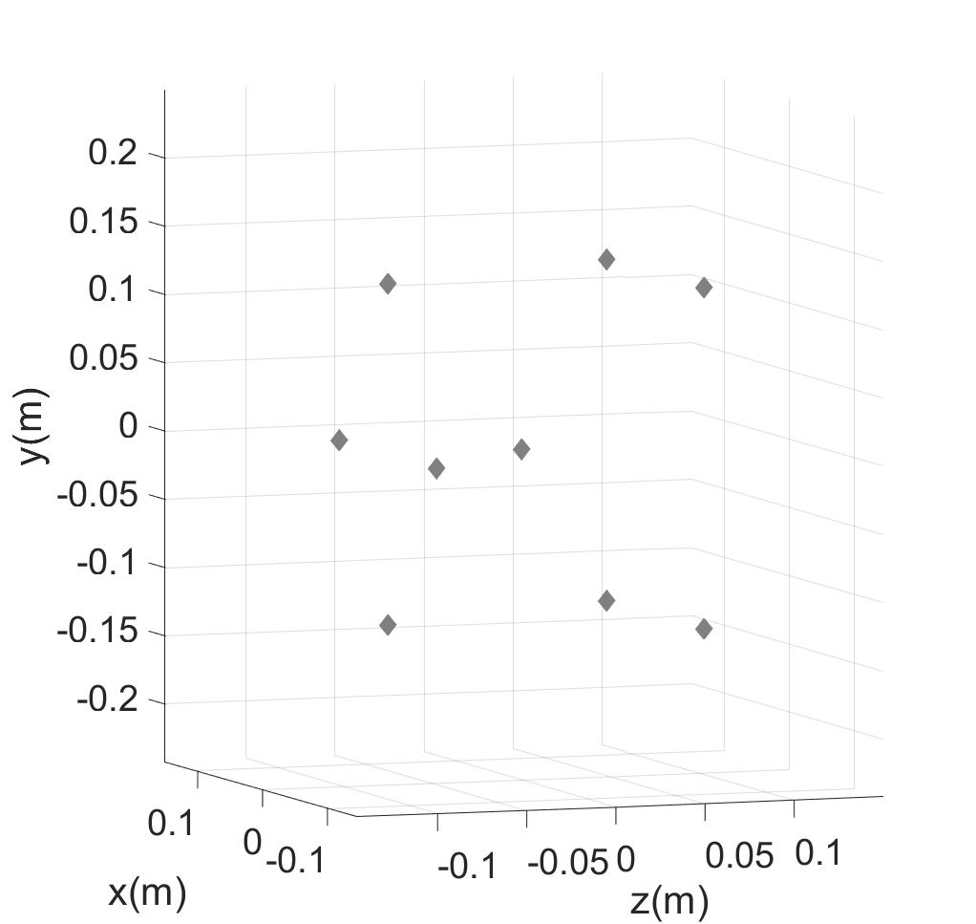
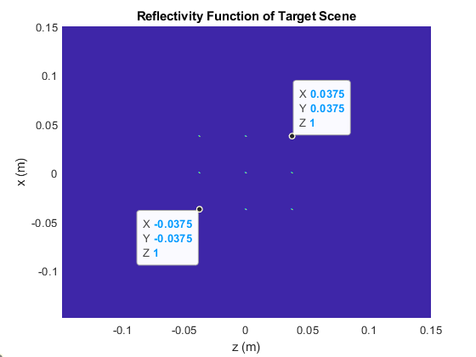
Grid of Points - Target Reflectivity Function
3D Reflectivity Function 2D Reflectivity Function

Slide 24
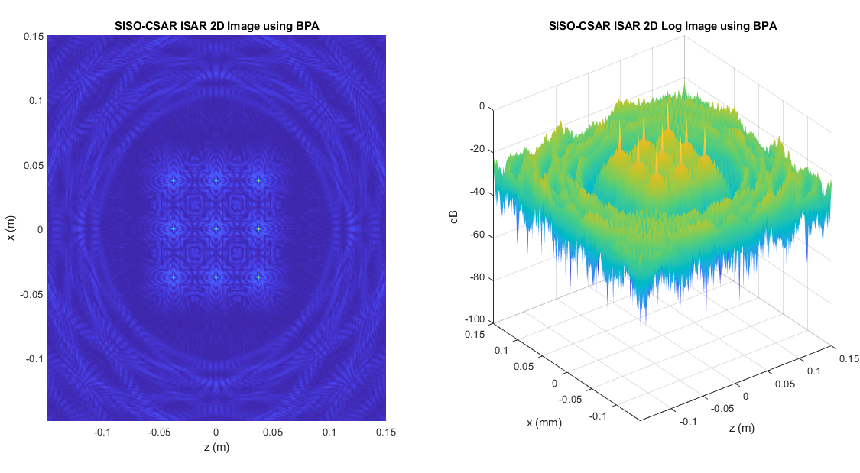
Back Projection Algorithm – 2D Simulations
Computation Time: 114s
Single channel chip used as target scene is rotated
Image shows minimal sidelobes

Slide 25
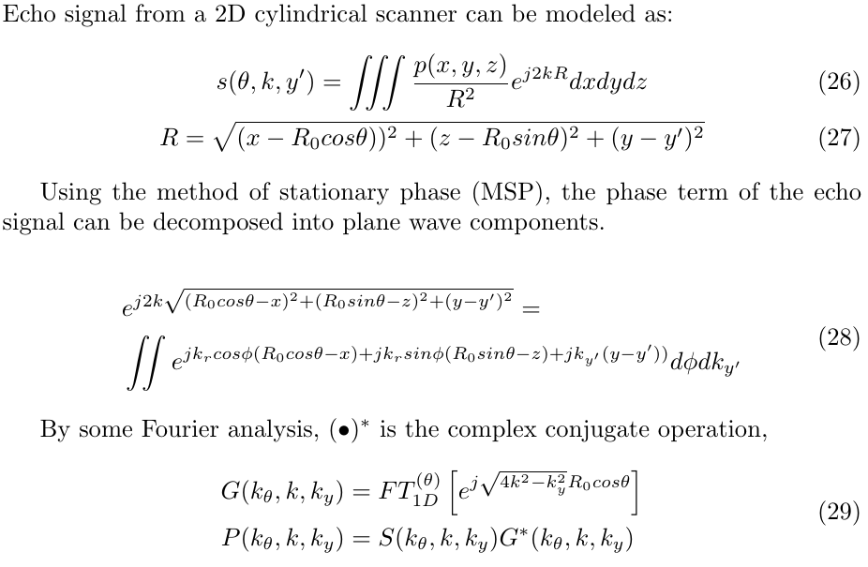
Polar Formatting Algorithm
Spherical wavefront
Decomposed by MSP
Reflectivity function in polar spectral coordinates

Slide 26
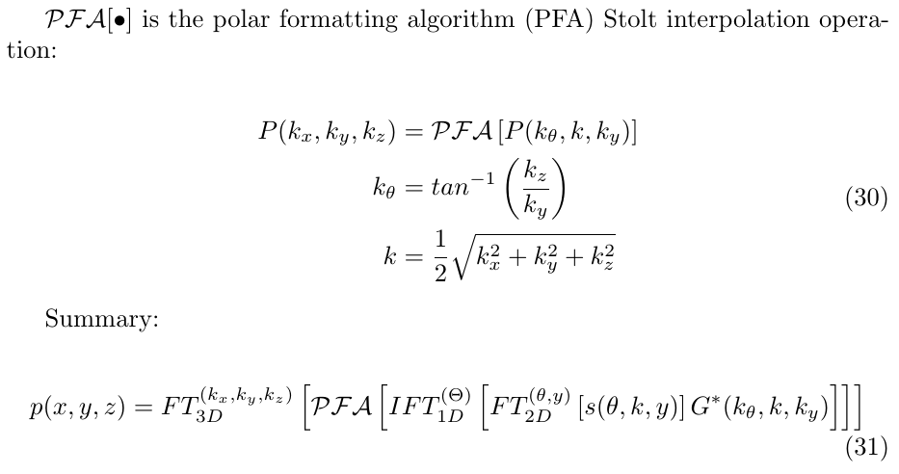
Polar Formatting Algorithm
*

Slide 27
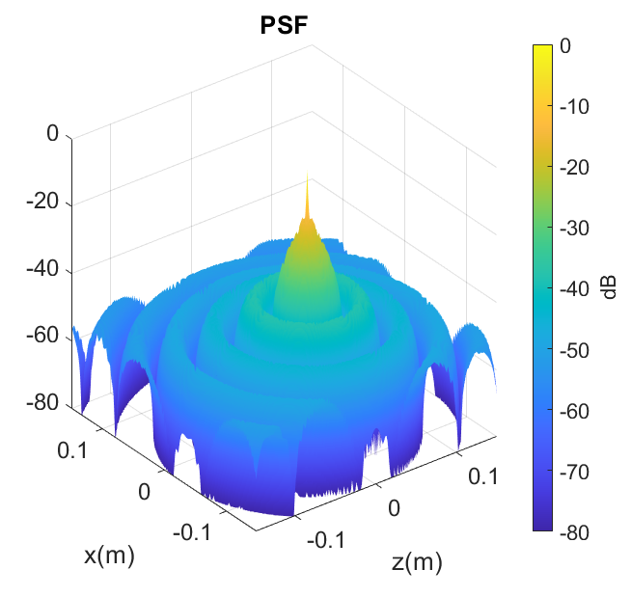
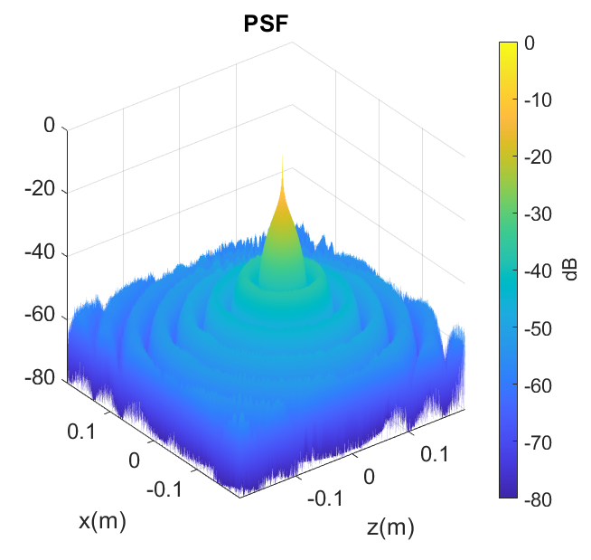
Point Spread Function – Comparison BPA vs. PFA
BPA (114s)
PFA (500ms)

Slide 28
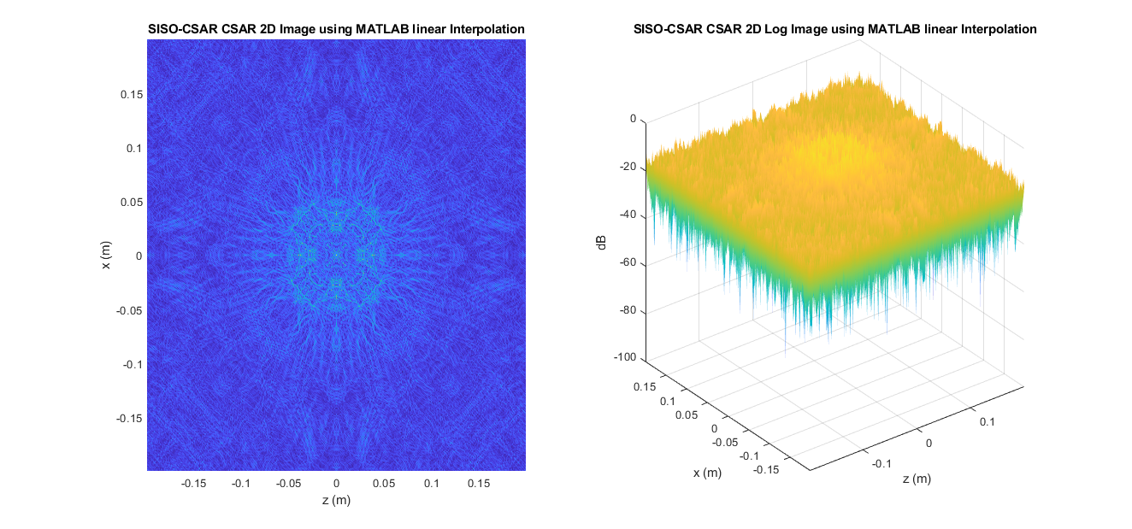
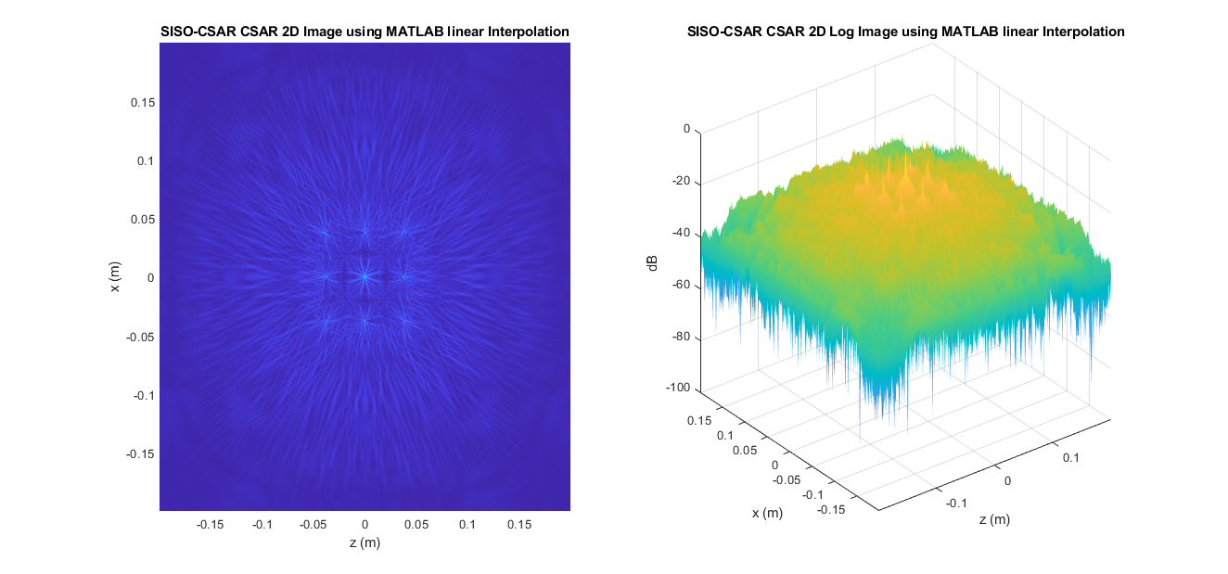
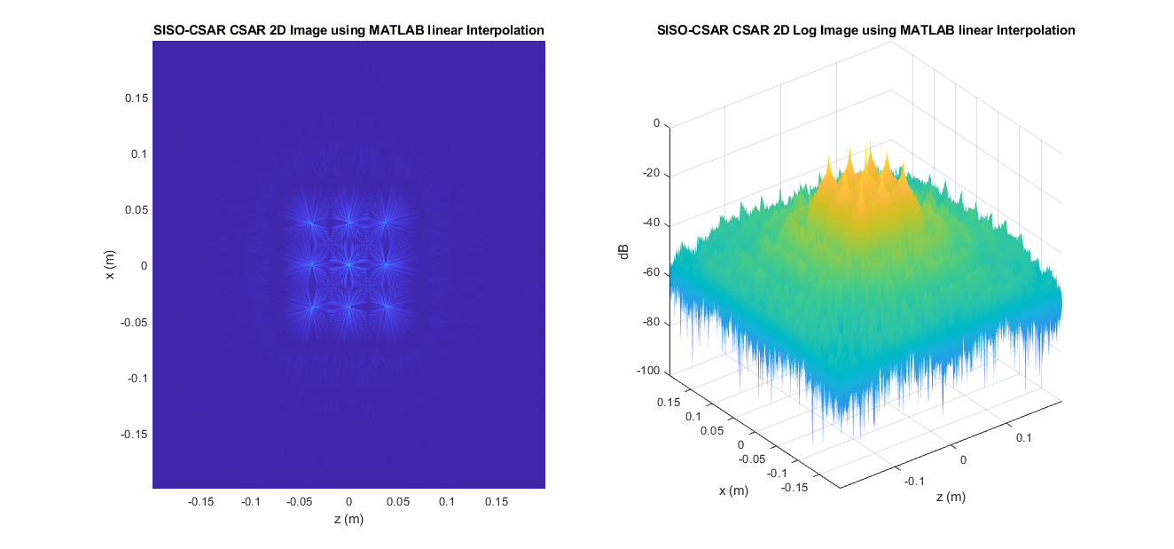
Polar Formatting Algorithm – 2D Simulations
Raw Echo Data
Upsampled x2
Upsampled x4
40ms
200ms
500ms

Slide 29
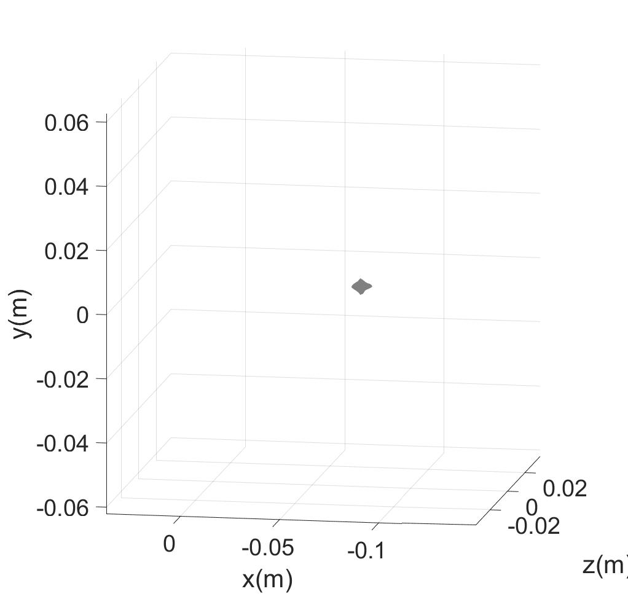
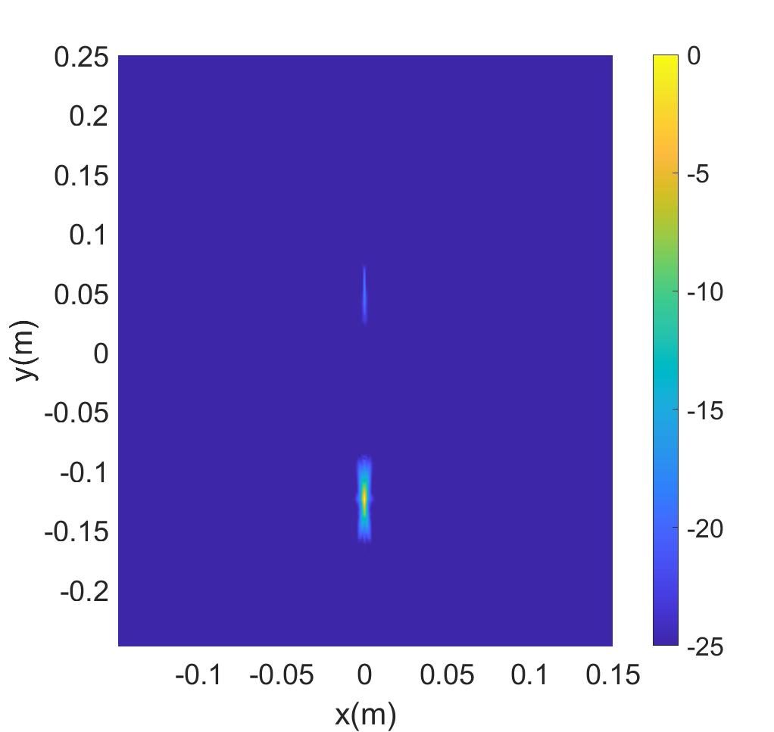
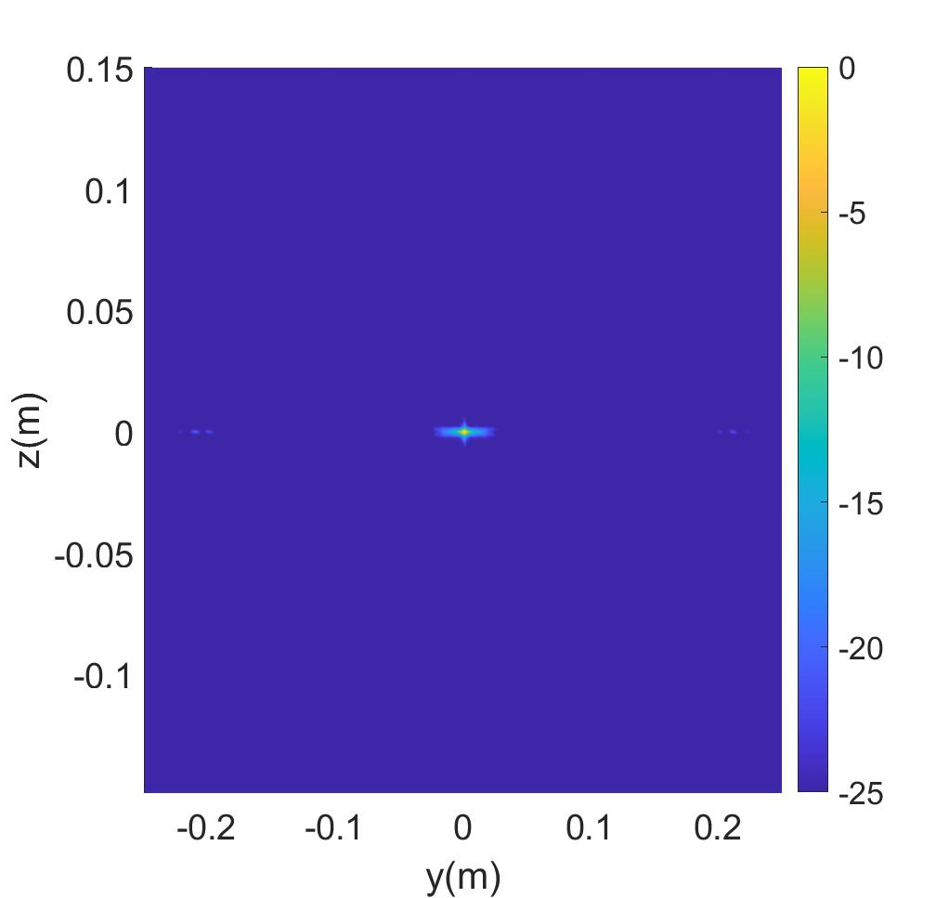
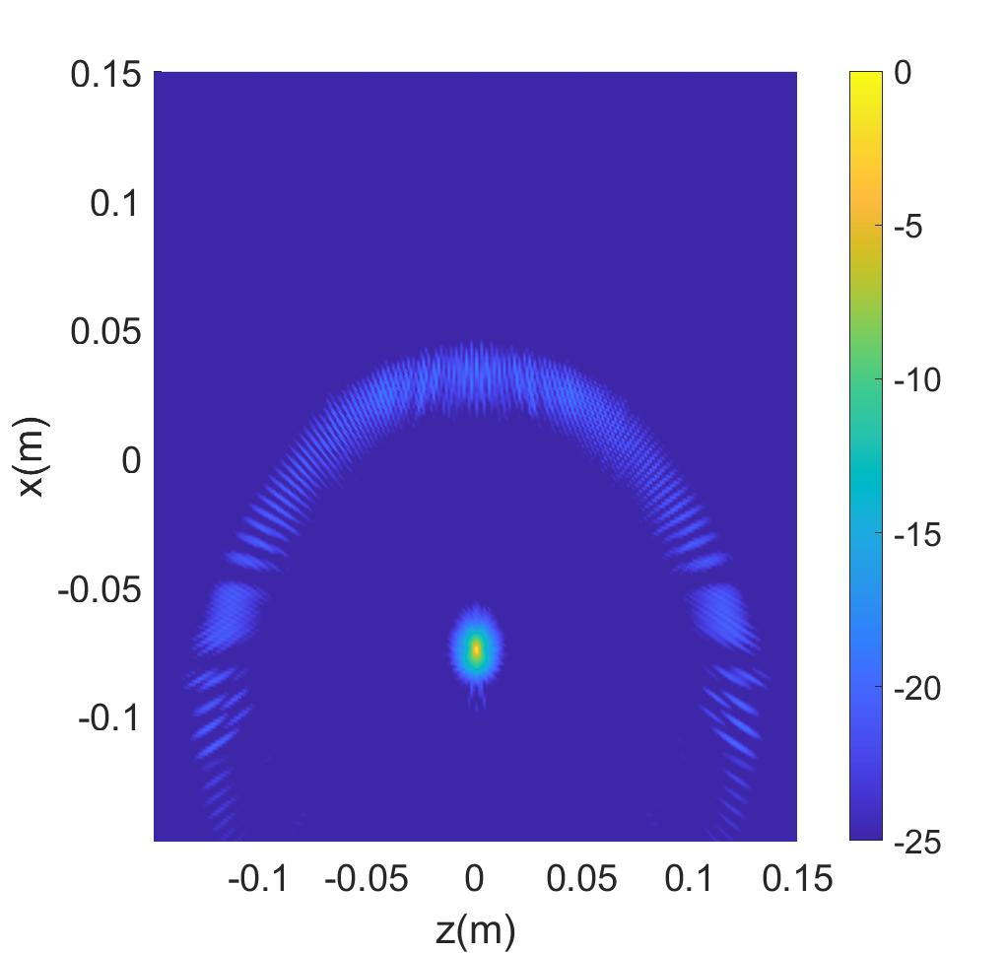
Polar Formatting Algorithm – 3D PSF
(x-y) PSF
(y-z) PSF
Reconstructed PSF
(x-z) PSF

Slide 30

Polar Formatting Algorithm – 3D Simulations
Input Reflectivity Function
Reconstructed Image

Slide 31
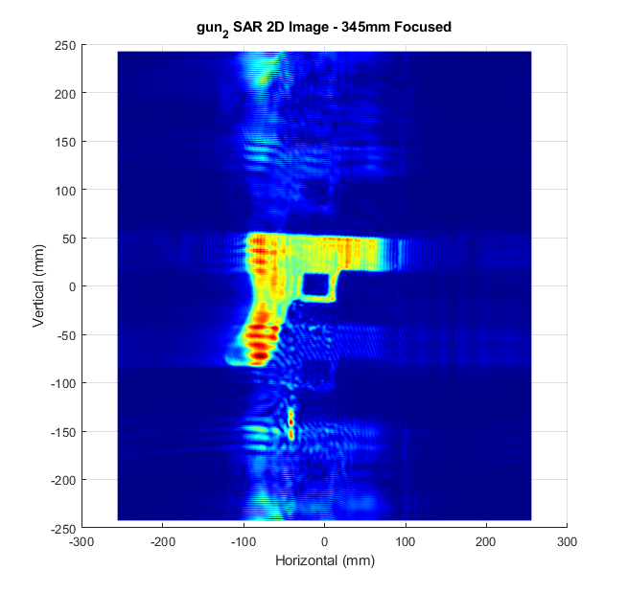
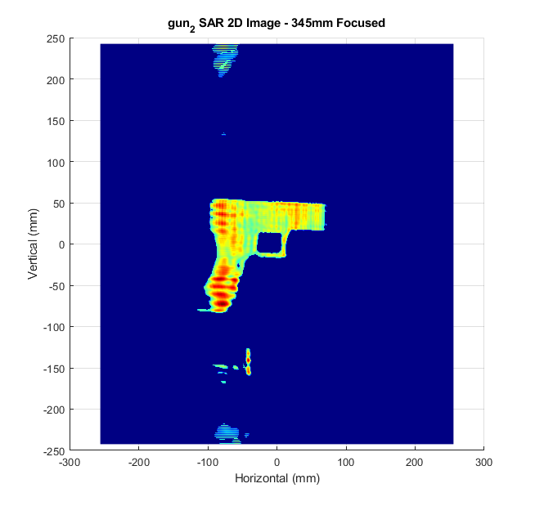
Scanner Results – Rectilinear Scanning – 2D Image
Data Capture
MIMO Conversion
Rectilinear Scanning
Cylindrical Scanning
Scanner Results
Without MIMO Conversion
With MIMO Conversion

Slide 32
Scanner Results – Cylindrical Scanning – 3D Image
Setup:
Large knife attached to rotator
MIMO radar scanned vertically
4GHz – bandwidth
79GHz – center frequency
1000 angular samples around 360° aperture
SISO Scan:
512 vertical positions
MIMO Scan:
(64 vertical positions) x (8 virtual channels) = 512 vertical virtual elements
8x Faster Scanning!

Slide 33
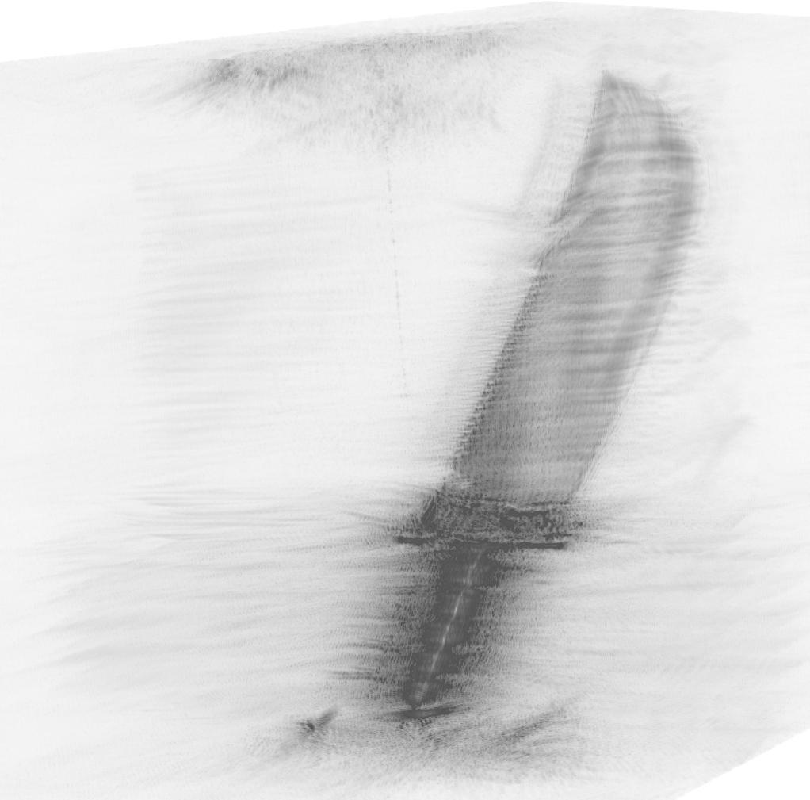
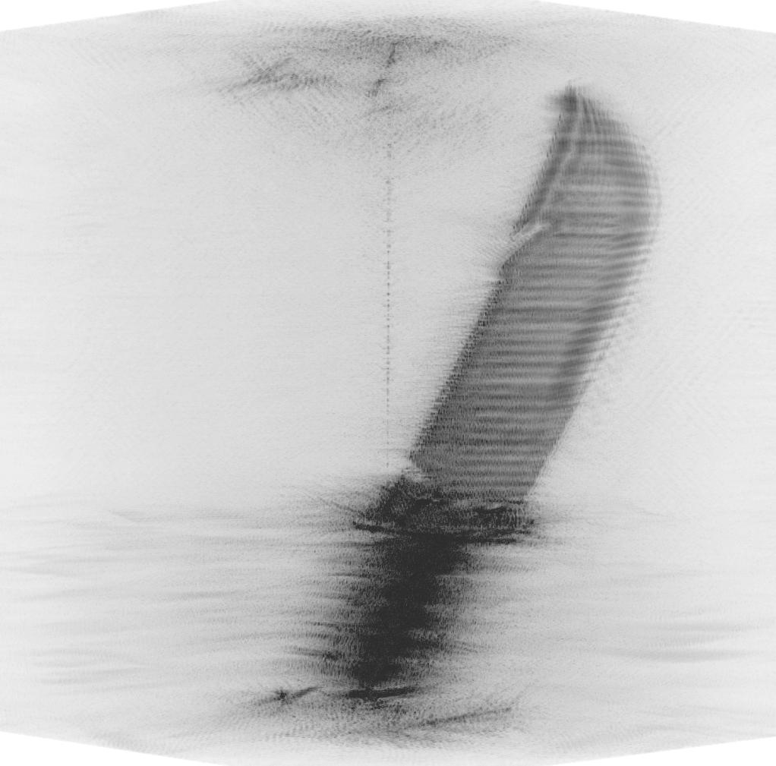
Scanner Results – Cylindrical Scanning – 3D Image
MIP- SISO R-ISAR Scan (150 min)
MIP – MIMO R-ISAR Scan (20 min)

Slide 34
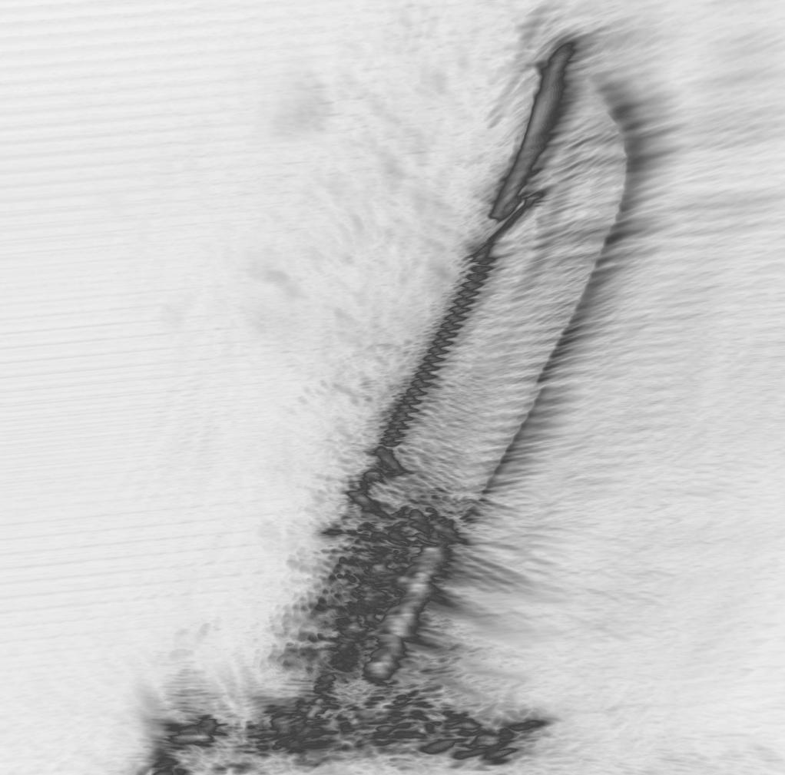
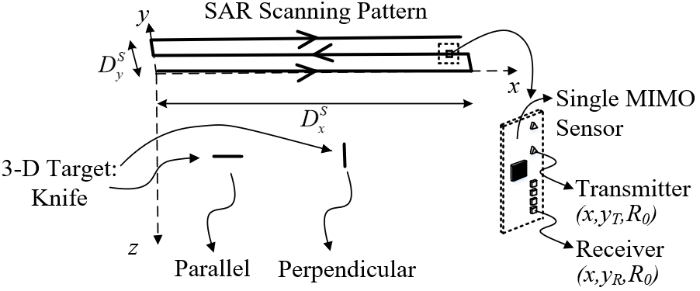
Scanner Results – Cylindrical vs. Rectilinear
Scanning Scenario
MIP – MIMO-SAR - Knife Parallel to Scanning Plane

Slide 35
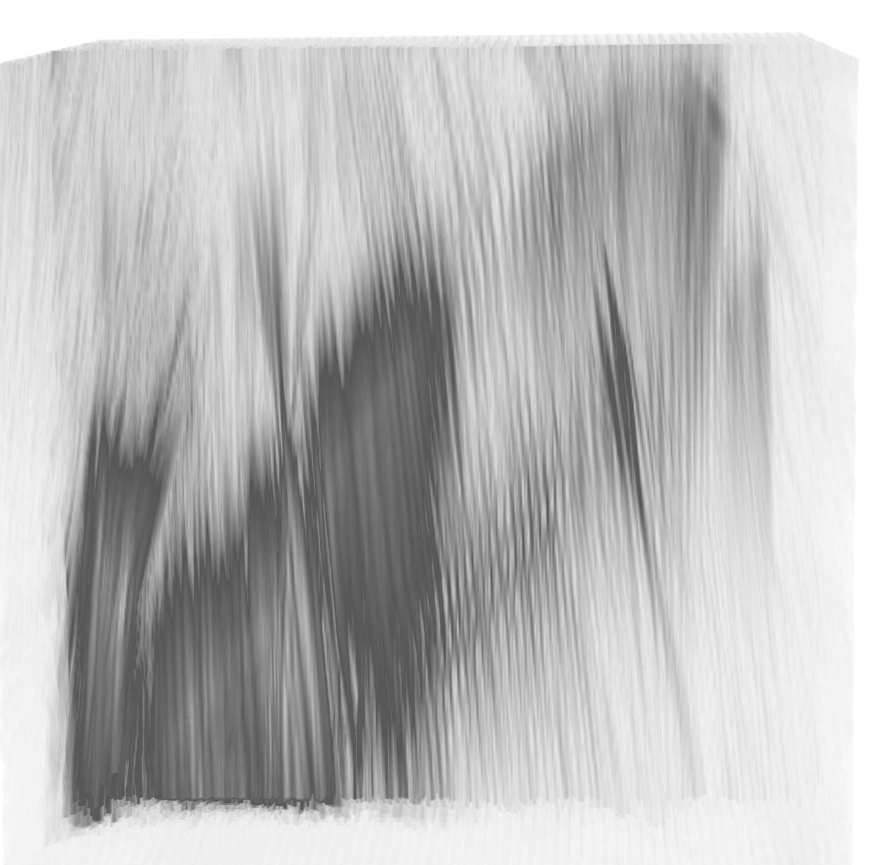
Scanner Results – Cylindrical vs. Rectilinear
MIP – MIMO R-ISAR – Orientation Invariant
MIP – MIMO-SAR - Knife Perpendicular to Scanning Plane

Slide 36
Conclusion and Future Work
Conclusion:
Efficient, high-resolution image reconstruction algorithms for rectilinear and cylindrical synthetic aperture radar scenarios
MIMO conversion: multistatic-to-monostatic conversion allows for use of efficient monostatic algorithms
Future Work:
Compare CSAR to SAR for concealed item detection
Apply machine learning to SAR imaging
Multistatic phase correction for large MIMO aperture
CV-FCNN for image reconstruction directly from echo data
Publications:
(Invited) Near-Field MIMO-ISAR Millimeter-Wave Imaging – IEEE RadarConf – Sep. 2020

Slide 37


Questions?

